Slide 1
Growing Stagecraft Rebecca Head, Michael Los and Melissa Rowse Colleagues who grow together as educators but also really like each other. 2.40 – 3.40pm (60 minutes)
Notes:
Meet and greet ☺ Standing in a circle, start on time.

Slide 2
Learning Intention
Success Criteria: Leave with practical exercises to apply with your students in exploring stagecraft
Knowledge: What is stagecraft and how it aligns with syllabi
Skill: Applying stagecraft to text
2.45pm

Slide 3
Prior Knowledge – The Dramatic Languages
Skills of Drama
Stagecraft
Elements of Drama
Forms and Styles
Conventions TASK: Dramatic Languages Cards
Notes:
Instruction: If everyone now gives it their best shot to place these cards in the correct categories, we work from a place of collective intelligence. So please don’t be threatened by this, but it does mean that if you see a card that you think is incorrect, please move it into the position you think that it belongs in. This may create some contention, but that’s leaning into the learning pit.

Slide 4
But what is Stagecraft?

Slide 5
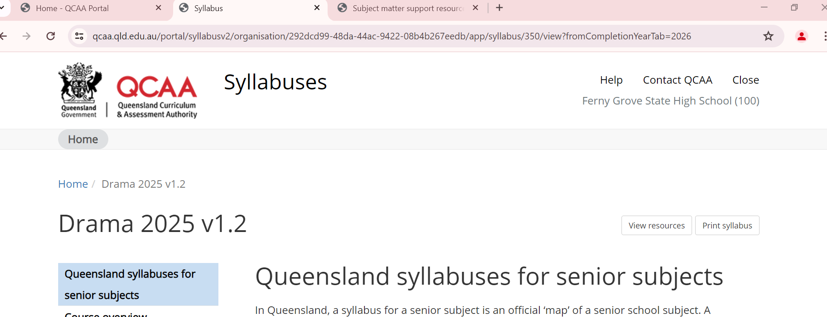
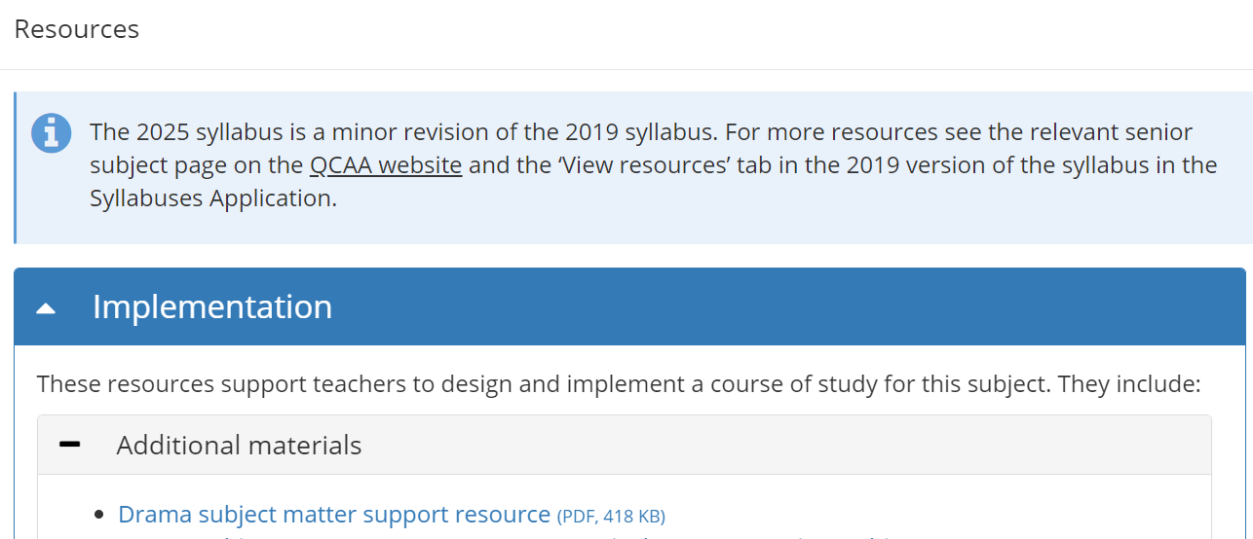
Notes:
Melissa to explain resource.

Slide 6
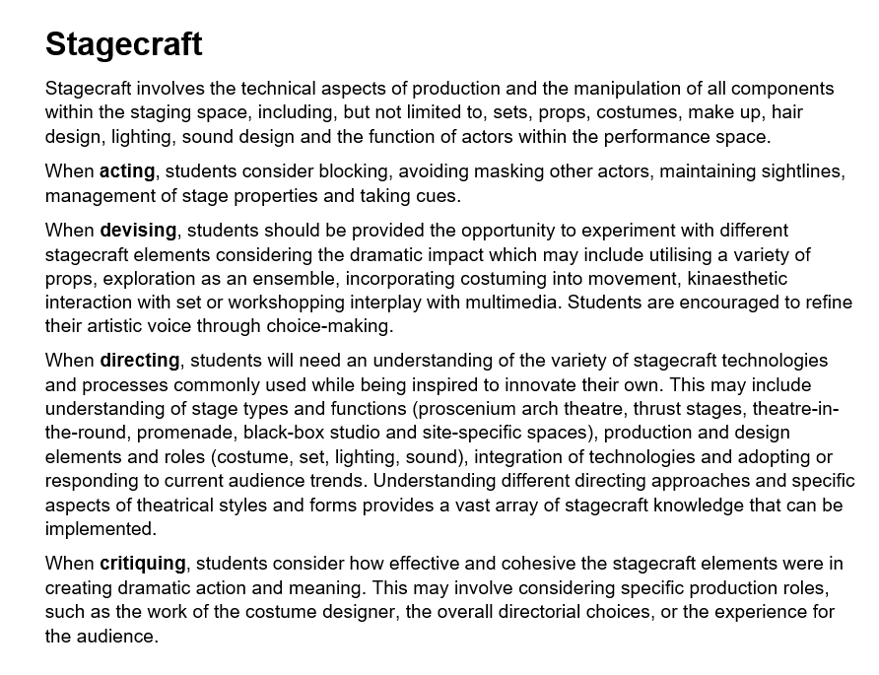

Slide 7
When acting, students consider blocking, avoiding masking other actors, maintaining sightlines, management of stage properties and taking cues.
When devising, students should be provided the opportunity to experiment with different stagecraft elements may include utilising a variety of props, exploration as an ensemble, kinaesthetic interaction with set.
When directing, students should have an understanding of stage types and functions (proscenium arch theatre, thrust stages, theatre-in-the-round, promenade, black-box studio and site-specific spaces).

Slide 8
The Stage – Making it fun!
Audience
Downstage Left | Downstage Centre | Downstage Right
Centre Stage Left | Centre Stage | Centre Stage Right
Upstage Left | Upstage Centre | Upstage Right
Notes:
Game
Knowing where you are on the stage and the space, using a shared language
Stagecraft quality of blocking, considering their positioning and the meaning. Considering their choice and their relationship to each other.
We are going to play the same game, this time layering on sight lines and blocking
Unpack focus, unpack mood, unpack the elements
Because we want to explore the other types of staging that we can use in drama, we need a text.

Slide 9
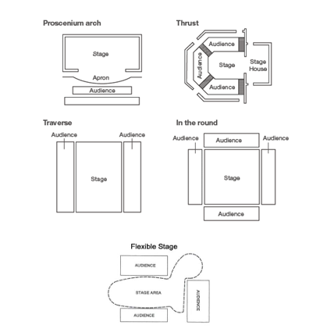
Syllabus Familiarisation
Thank you Michelle Murtagh

Slide 10
The day he became king of the world, the boy walked down the main street and all the cars honked their horns! And … and he marched into the town zoo and went straight up to the biggest lion, and it bowed down reverently to him. And he rode it everywhere after that! Raaaa!

Slide 11
Meaning and Mood
Mood – Joy
Meaning – The power of a child’s imagination Task: Shape the text for a proscenium arch stage so that this mood is created and this meaning is communicated.

Slide 12
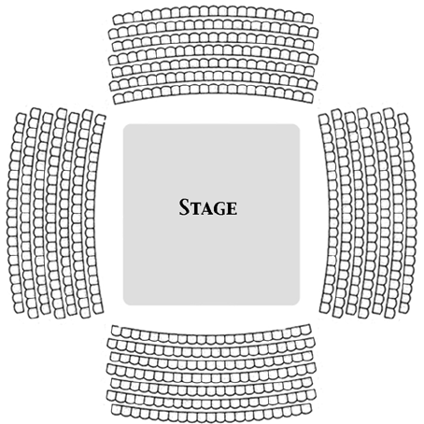
Theatre in the round – Arena Stage
Consider that the audience get different viewpoints, actors have to keep on moving, stage framing can be inconsistent,. Actors have the ability to create intense moments of connection on stage through eye sight, but need to avoid eye contact with the audience.
Notes:
Okay, now we are going to consider where the audience sits impact. Embed props

Slide 13
Meaning and Mood
Mood – Joy
Meaning – The power of a child’s imagination Task: Shape the text for theatre in the round, so that this mood is created and this meaning is communicated.

Slide 14
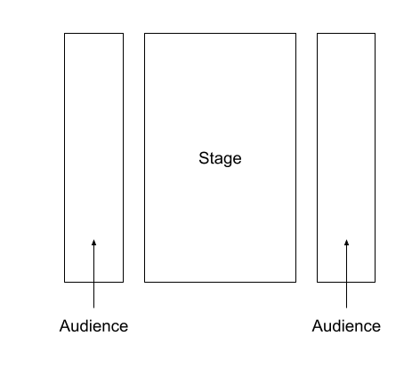
Traverse Stage
Consider that blocking is impacted by the lack of a clear downstage or upstage. Consider that actors need to constantly turn, to ensure the audience can see. Benefit is dynamic between audience and actors,
Notes:
Okay, now we are going to consider where the audience sits impact

Slide 15
It’s all about the blocking

Slide 16
TEXT
SLEEP I can’t sleep.
Hot milk. I hate it now.
Book?
I haven’t got one I like. Just lie there and breathe.
My head’s to full of stuff. Are you asleep?
No no, what, it’s fine. You can’t sleep?
I think I’ll get up and go on Facebook? Task: New partner who you haven’t worked with today. You have 3 minutes to work the scene. The audience is here. Set options?

Slide 17
Blocking – What do we really do?
The first thing that we are given as teachers, is a space. It’s the classroom. They come from the point of view as an actor, for their concepts they need to extend their mind outside of the classroom setting and into that of the director.
Can you all please walk out the floor pattern of the space you just used.
Typically we find that if we don’t instruct our students they use a small space.
Now we are going to ask you to rework your scene with the following constraints: you must use the entire space, you must maintain eye contact, you must not ever be closer than 2m.

Slide 18
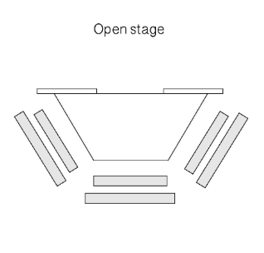
Space Constraint
Now you will change your stage, your stage is now a triangle, these are your sightlines, decide now which place you are in (packed train, toilet, cupboard, public transport, car, lift).
Each group must use one piece of costuming

Slide 19
Run Scene – Elimination

Slide 20
Kinaesthetic Interaction with Set

Slide 21
Chair – Beck and Michael
What is the object (literal)
What is this object in this scene, what is the significance of this?
How does your interaction with that object communicate meaning?
Example – What do our students do?
All dramatic languages are interconnected.
Our form is minimalism, our convention is fluid time and place.
Version One – We used the chair as a piece of set
Version Two – Kinaesthetic interaction with the set

Slide 22
Task: YOU DO Chair
With a small piece of text, that you shaped before can you please layer in this kinaesthetic use of set via the chair.
Shared understanding of your human context
3 minutes
As previously stated the dramatic languages work together, such as Fluid Time and Place. Start at one Place and fluidly move to a bedroom, or a bathroom. Another convention, transformative set can be implemented here. Is your chair now a bobcat? Is you chair a handbag? A beanbag?
3 minutes

Slide 23
Thank you!
We need to explicitly teach stagecraft, and we need out students to be able to articulate how they are using stagecraft.
We would appreciate if you’d share a takeaway via filling in our exit ticket, OR as you leave record your voice with Beck or Michael

